Slide 1
Measuring Magnetic Reconnection in Solar Flares
Audrey Robison
Midterm Presentation
REU Summer 2022

Slide 2
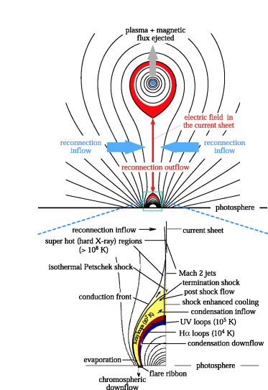
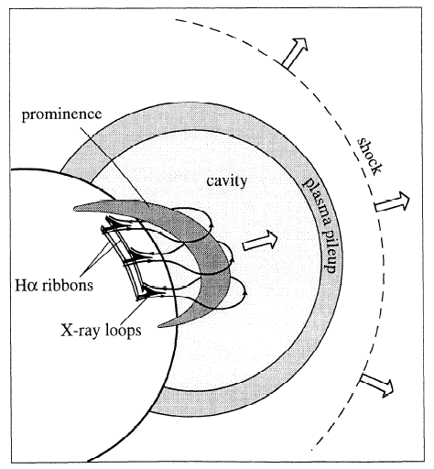
Magnetic Reconnection on the Sun’s Surface
Forbes- Lin model
Notes:
What is the solar flare, how is it associated with magnetic reconnection. As a coronal mass ejection breaks away from the sun, reconnected loops are left on the surface of the sun, these are solar flares. Energy is released into a solar flare due to magnetic reconnection. This energy brightens the feet of the solar flare, what we call the ribbons. The ribbons brighten and propagate outward, as the solar flare evolves.

Slide 3
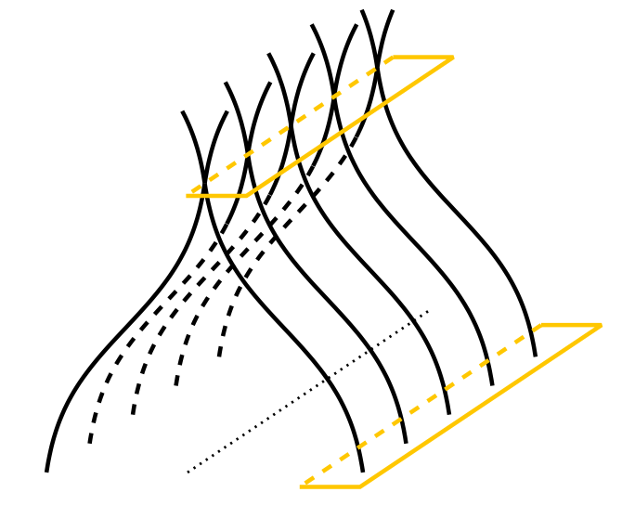
Theories of Reconnection
B_{in}
reconnection
V_{in}
dA_{in}
B_{R}
reconnection
rate (general)
dA_{R}
Terry Forbes
Notes:
Flare ribbons are the location where the energy flows into the chromosphere mapping where reconnection has taken place. Over time, as more field lines reconnect, the flare ribbons move outwards, as field lines further out have reconnected. The flare ribbons brighten before the loops brighten because there is a time delay of when the energy can travel up through the field lines to brighten. Thus, the flare ribbons brighten before their associated flare loops have brightened. As time progresses, the flare ribbons will bloat and travel outwards, as the inner lines have connected the outer lines will begin to connect.

Slide 4
Goals of the Study
Measurement of Reconnection Rate
Measurement of Reconnection Shear
Notes:
My two goals for this project are to measure the rate and shear of magnetic reconnection. The rate is the change of flux over time within a solar flare. The shear is a geometric property describing the angle at which the loops reconnect.

Slide 5
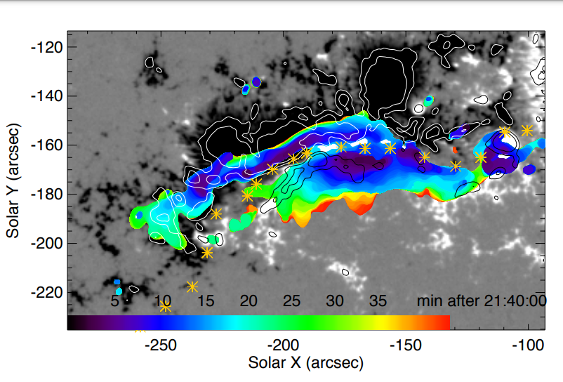

Measuring Reconnection Rate
B_{in}
reconnection
V_{in}
dA_{in}
B_{R}
reconnection
rate (general)
dA_{R}
$$Φ_{B}= \int{B_{in}}{dA}_{in}=\int{B_{R}}dA_{R}$$
Notes:
The amount of flux out must equal the amount of flux into the page. Using the identified flare pixels we can measure the flux in and out of the page using our magnetic data. Using this data over time we can estimate the rate of reconnection by taking an integral of this value. In this first image we have mapped the flare pixels with the general pixels that they connect to because the portion of flux in the blue is equal to the amount of flux in the blue on the other side.
Evolution of flare ribbon over magnetic field, color indicates times

Slide 6
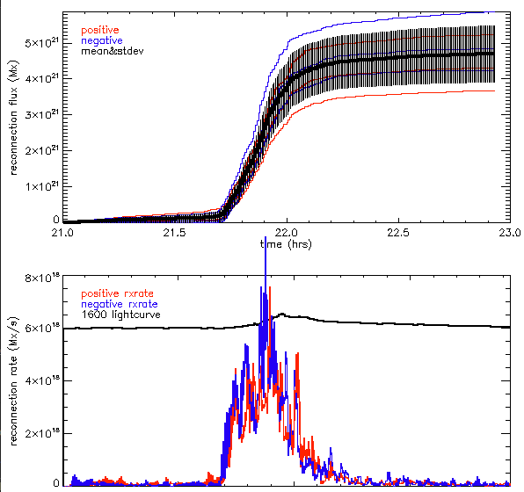
Graph of reconnection flux and reconnection rate
Notes:
Blue: negative red: positive. The lines indicate the amount of flux in each flare pixel over time. The negative is represented by blue and the positive by red. The first graph indicates the flux over time and the second indicates the change in flux over time or the reconnection rate. I generated these graphs in the first week, achieving the first goal of this summer research program, measuring the rate of reconnection.

Slide 7
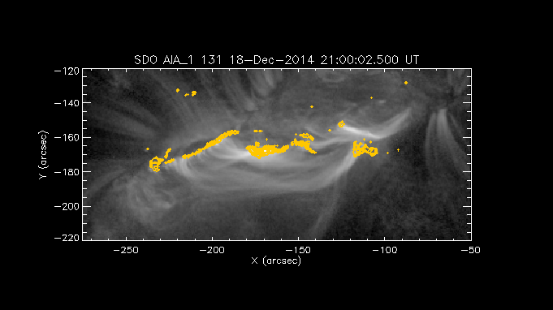
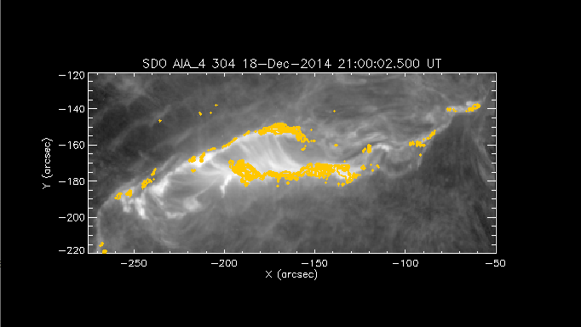
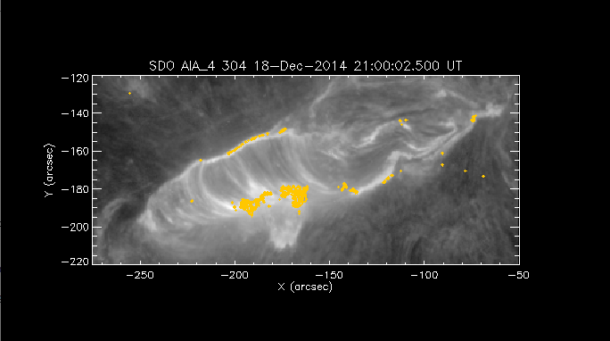
Reconnection Shear
B_{in}
reconnection
V_{in}
dA_{in}
B_{R}
reconnection
rate (general)
dA_{R}
Notes:
Strong to weak shear evolution of flare reconnection, polarity inversion line (division between positive and negative mag fields). However, we are working with two dimensional data and attempting to extrapolate it into three dimensions. As the flare evolves, the angle it cuts with the polarity inversion line increases. At a small angle, the shear is very high, as the flare progresses, the angle approaches 90 degrees, a low shear. This image represents a solar flare without any shear. With the shear of the loops we will be able to represent the three dimensional form of the loops, all of our observations are two dimensional projections of the loops as viewed from the surface of the sun.

Slide 8

Methods for Measuring Reconnection Shear
Combining observations with mathematical model
Force Free field
Alpha = 0 for potential
Higher alpha values correspond to higher shear, lower alpha values correspond to lower shear
$$\vec{∇}×\vec{B}=α\vec{B}$$
Notes:
To gain a three-dimensional model of flare reconnection, After reconnection loops are in equilibrium state, a force free field.

Slide 9
Preliminary Results
Three phases of Flare Evolution
High Shear
Rapid Expansion
Slow Expansion
Phase 2
Phase 1
Phase 3

Slide 10
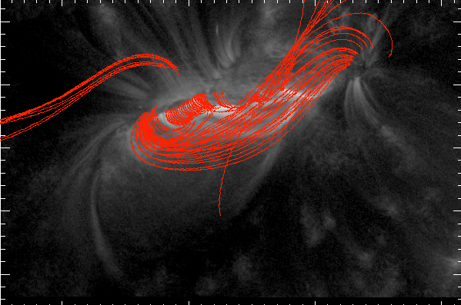

Phase 1: High Shear
$$α=0.05$$

Slide 11
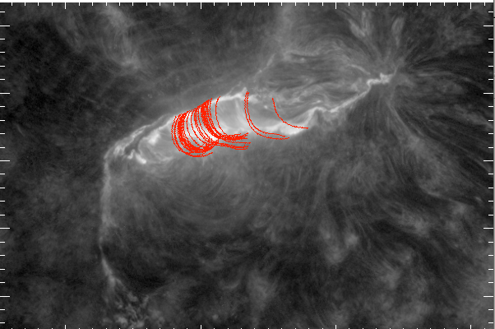

Phase 3: Slow Expansion
$$α=0.0$$

Slide 12
Future Steps
Our equation models the value of alpha in three phases
Next step: more accurate determination of value of alpha using automated model observation comparison
This is the quantitative characterization of the magnetic reconnection in 3D

